Slide 1
GNANAMANI COLLEGE OF
TECHNOLOGY(Pachal,Namakkal.)
DEPARTMENT OF BIOMEDICAL ENGINEERING
(Third Year)
Title: Flood Monitoring and Early Warning Team Members: J.Justine
M.Mugeshkannan
G.ponchezhiyan
S.Prathap
S.Venkatesaperumal
BY
s.venkatesaperumal

Slide 2
FLOOD MONITORING AND EARLY WARNING
Problem:
Inefficient flood management and delayed early warning lead to significant damage and risk to lives during flood events.
Flood Monitoring with IoT Sensors:
Traditional flood monitoring systems are often costly and not widespread leaving many areas vulnerable.
Data Transmission:
Transmitting flood data from remote areas to central monitoring stations can be challenging.
Data Analysis and Prediction:
Without effective data analysis its difficult to predict and issue flood warnings.
Early Warning Alerts:
Delays in alerting the public can result in serve consequences.
Remote Monitoring and Control:
Flood management often requires manual interventions.
Community Engagement:
Lack of public awareness and understanding can hinder evacuation efforts.
Redundancy and Backup
System failness during floods can be catastrophic.
INTRODUCTION
Arduino based flood detection system an innovative solution for early flood warning.

Slide 3
Floods are one of the most devastating natrul disasters , causing devastating damage to property to,infrastructure and human life.Early warning systems are becoming increasingly important to minimize damage from floods . An Arduino based flood detection system is one such innovative solution , providing real-time monitoring and early warning of potential flood .
The main purpose of flood detection system is to detect the occurrence of floods and alert authorities and local resistance to take necessary measures to minimize damage and save lives.
One of the key components of an Arduino-based flood detection system is the flood sensor. There are many types of flood sensors, but the most commonly used are water level sensor. This sensor uses ultrasonic technology to accurately measure the water level and triggers an alarm when a pre-defined threshold is reached .
WORKING
The system consist of an Arduino microcontroller, a water level sensor and an alarm system. water level sensor are strategically placed to continuously measure water level. Data collected by the sensor is sent to the Arduino microcontroller.
The microcontroller processes a data and compares it with specified threshold. When the water level exceeds a threshold, the microcontroller triggers an alarm system to alert local authorities and residents.
In summary, the Arduino-based flood detection system is an innovative and cost- effective solution for early warning of floods. Its versatility and ease of use make it suitable for a wide range of applications, and its integration with other systems provides a comprehensive and reliable solution for producting life and property from flood damage.
I hope this article meets your requirments and provides valuable information about the Arduino-based flood detection system.
Looking ahead to future advances, researches are investigating the possibility of incorporating artificial intelligence and machine learning algorithms into flood detection system to improve there accuracy and effectiveness. This allows the system to automatically adopt to changing environmental conditions and predict potential floods more accurately.
Over all, the Arduino-based flood detection system is a valuable tool for communities and organisations that are vulnerable to the effects of floods. With it is a valuable investment for producting life and property from the devastating effects of floods .
SOFTWARE:

Slide 4
Software used for Arduino-based flood detection system project is Arduino IDE.
ARDUINO IDE: this is the primary software for programming Arduino boards . you can download it from the official Arduino website.
PHASE-2
INNOVATION
Components Needed:
Arduino microcontroller (e.g., Arduino Uno)
Water level sensor (e.g., ultrasonic, float switch, or capacitive)
Alarm system (e.g., buzzer, LED indicators)
Optional: GSM module or Wi-Fi module for remote alerts
Sensor Installation:
Mount the water level sensor at a strategic location near the flood-prone area, ensuring it’s secure and protected from damage.
Connect the water level sensor to the Arduino according to its datasheet or manufacturer’s instructions.
Programming the Arduino:
Write Arduino code to read data from the water level sensor. The code should convert sensor data into meaningful water level information.
Set up threshold levels for different flood stages (e.g., low, moderate, high).
Implement algorithms to analyze sensor data and trigger appropriate responses when water levels rise above predefined thresholds.
Warning System:
Connect an alarm system (e.g., buzzer, LEDs) to the Arduino. These will serve as local warning indicators.

Slide 5
- Program the Arduino to activate the alarm when the water level exceeds the predefined thresholds.
Data Logging and Remote Alerts (Optional):
If desired, add a data logging capability to record water level data over time.
For remote alerts, integrate a GSM or Wi-Fi module. When the Arduino detects a flood situation, it can send alerts via SMS, email, or push notifications to relevant authorities or individuals.
Power Supply:
Ensure a reliable power supply for the Arduino and associated components, considering backup power options such as batteries in case of power outages.
Testing and Calibration:
Test the system by simulating different water levels. Verify that the Arduino correctly detects flood conditions and activates the alarm.
Calibrate the system if necessary to improve accuracy.
Deployment and Maintenance:
Install the system in flood-prone areas, ensuring it’s weatherproof and well- maintained.
Regularly check and maintain the system to ensure it functions correctly.
Data Visualization (Optional):
Consider creating a user-friendly interface to visualize water level data in real-time, which can be accessed remotely via a web or mobile app.
10. Community Out reach:

Slide 6
- Raise awareness about the system within the community and provide clear instructions on what to do in case of flood alerts.
11. Emergency Response Plan: - Work with local authorities to establish an emergency response plan based on the flood alerts generated by the system.
PHASE-3 DEVELOPMENT-1
Hardware Setup:
Choose the appropriate Arduino board (e.g., Arduino Uno, Arduino Nano) and a compatible water level sensor (e.g., ultrasonic sensor or float switch).
Connect the water level sensor to the Arduino board, ensuring proper wiring and power supply.
Data Acquisition:
Program the Arduino to read water level data from the sensor at regular intervals.
Convert the sensor’s analog or digital output into meaningful water level measurements.
Data Logging:
Set up a method to log the water level data. You can use an SD card module or send the data to a computer or cloud-based platform for storage.
Data Transmission:
If needed, establish a way to transmit the data wirelessly to a central server or location using modules like Wi-Fi, GSM, or LoRa.
Data Processing:

Slide 7
- Develop algorithms to process the collected data. Calculate flood risk levels based on thresholds, historical data, and weather information.
Early Warning System:
Implement a warning system that can trigger alarms, notifications, or alerts when the water level reaches a critical point.
User Interface:
Create a user interface for monitoring and configuring the system. This could be a simple LCD display on the Arduino or a more advanced web-based dashboard.
Power Supply and Backup:
Ensure the system has a reliable power supply and consider implementing backup power sources (e.g., batteries) to maintain operation during power outages.
Testing and Calibration:
Thoroughly test the system and calibrate the water level sensor to ensure accurate measurements.
10. Data Collection and Dataset:
Collect data over time to build a dataset for flood monitoring. This dataset should include water level readings, timestamps, and any other relevant information, such as weather conditions.
Label the data to indicate flood occurrences and non-flood periods.
11. Data Analysis:
- Analyze the collected dataset to identify patterns and trends that can be used for flood prediction and early warning.

Slide 8
12. Machine Learning (Optional):
- Consider using machine learning algorithms to improve flood prediction and early warning capabilities based on historical data and real-time information.
13. Community Engagement:
- Involve local communities, authorities, and disaster management agencies in the deployment and usage of the system to ensure effective early warning and response.
14. Documentation:
- Document the entire project, including hardware and software specifications, for future reference and replication.
PHASE-4 DEVELOPMENT-2
Data Collection:
Use a water level sensor to measure water levels in a specific area.
Interface the sensor with an Arduino microcontroller to collect real-time data.
Feature Engineering:
Extract relevant features from the data, such as water level measurements, time, and location.
Calculate additional features like rate of change in water level, cumulative rainfall, or historical data for trend analysis.
Data Processing:
Filter and preprocess the data to remove noise or outliers.
Aggregate data over time intervals (e.g., hourly or daily) for analysis.

Slide 9
Early Warning System:
Define thresholds for water levels that indicate flood risk.
Implement an alerting mechanism (e.g., SMS, email, or visual/audible alarms) when the water level exceeds these thresholds.
Machine Learning Models:
Train machine learning models to predict flood risk based on the features and historical data.
Common models include regression, time series analysis, or deep learning models for more complex patterns.
Training and Evaluation:
Split your dataset into training and testing sets to train and evaluate your models.
Use evaluation metrics like Mean Absolute Error (MAE), Mean Squared Error (MSE), or accuracy to assess model performance.
Real-Time Monitoring:
Continuously collect and update data from the water level sensor.
Utilize your trained model to make real-time predictions or forecasts.
Alerting Mechanism:
When the model predicts a flood risk based on the real-time data, trigger the early warning system to alert relevant authorities or residents.
User Interface:
Create a user-friendly interface to display real-time data, alerts, and historical trends.

Slide 10
10. Deployment and Testing:
Deploy the system in the target area and thoroughly test it under various conditions.
Ensure the reliability of the hardware and software components.
11. Maintenance:
Regularly maintain and calibrate the hardware.
Update the machine learning models and data as necessary for better predictions.
12. Community Engagement:
- Educate and engage the local community on how to respond to alerts and warnings effectively.
PROJECT COMPLETION
Creating a complete flood monitoring and early warning system for Arduino is a complex project that involves various components and coding tasks. Below, I’ll provide you with a simplified example code for monitoring water levels using an ultrasonic sensor and sending alerts via SMS using a GSM module. This is just a starting point, and you would need to expand and customize the code to meet your specific requirements and integrate other sensors as needed.
Here’s a basic Arduino sketch for this purpose:
```cpp
#include <SoftwareSerial.h>
// Define pin numbers for the ultrasonic sensor Const int trigPin = 9;
Const int echoPin = 10;

Slide 11
// GSM module setup
SoftwareSerial gsmSerial(7, 8); // RX, TX
String phoneNumber = “+1234567890”; // Replace with your phone number
Void setup() {
// Initialize the serial communication with the GSM module gsmSerial.begin(9600);
// Initialize the serial communication for debugging
Serial.begin(9600);
// Ultrasonic sensor pins pinMode(trigPin, OUTPUT); pinMode(echoPin, INPUT);
}
Void loop() {
// Trigger the ultrasonic sensor
digitalWrite(trigPin, LOW); delayMicroseconds(2); digitalWrite(trigPin, HIGH); delayMicroseconds(10); digitalWrite(trigPin, LOW);
// Read the distance from the ultrasonic sensor Long duration = pulseIn(echoPin, HIGH);
Int distance = duration / 29 / 2; // Calculate distance in centimeters

Slide 12
Serial.print(“Distance: “); Serial.print(distance); Serial.println(“ cm”);
// Check if the water level is above a certain threshold (adjust as needed) If (distance < 30) {
sendSMS(“Flood Alert! Water level is high.”);
delay(60000); // Send only one alert per minute to avoid flooding the system
}
Delay(5000); // Wait for a few seconds before the next reading
}
// Function to send an SMS using the GSM module Void sendSMS(String message) {
gsmSerial.println(“AT+CMGF=1”); // Set SMS mode to text delay(100);
gsmSerial.println(“AT+CMGS=\”” + phoneNumber + “\””); // Specify the recipient’s phone number
delay(100);
gsmSerial.println(message); // The SMS content delay(100);
gsmSerial.println((char)26); // Send Ctrl+Z to indicate the end of the message
delay(100); gsmSerial.println();
}

Slide 13
```
This code assumes you have an ultrasonic sensor connected to pins 9 and 10 for measuring water levels and a GSM module connected to pins 7 (RX) and 8 (TX) for sending SMS alerts. Replace `phoneNumber` with the phone number you want to receive alerts.
Please note that this is a simplified example, and a real-world flood monitoring system would require more robust error handling, additional sensors, data logging, and a comprehensive alerting system. Be sure to adapt and expand the code to suit your specific needs and consider the power source and deployment environment of your system

Slide 14
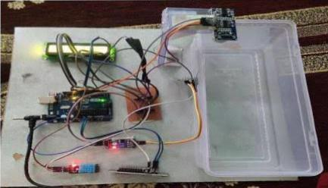
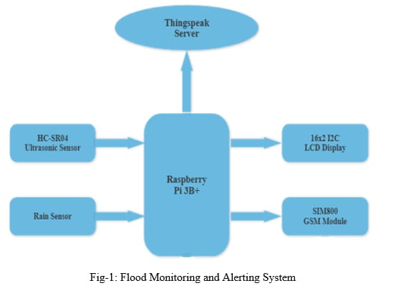
The process for implementing a flood monitoring and early warning system using IoT technology involves several key steps. First, sensor devices are deployed in flood-prone areas to monitor water levels and weather conditions. These sensors collect real-time data and transmit it to a central control system. The control system processes the data and triggers alerts if it detects potential flood conditions. These alerts can be sent to relevant authorities and the public through various communication channels, such as mobile apps, SMS, or sirens. Additionally, a user-friendly interface is developed to visualize the data and provide updates to stakeholders. Regular maintenance and testing of the system are essential to ensure its reliability and effectiveness in providing early flood warnings

Slide 15
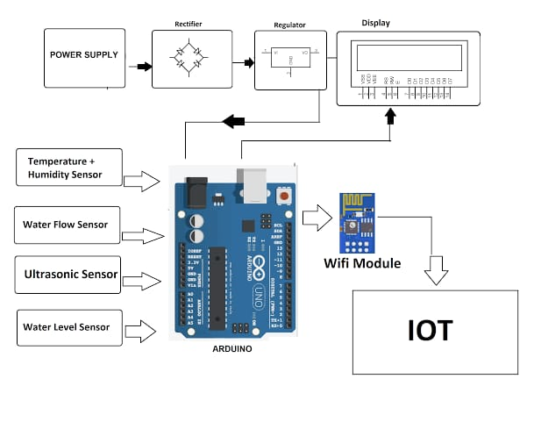
Conclusion:
the implementation of a flood monitoring and early warning system using IoT technology is a critical initiative to mitigate the impact of flooding events. This project involves the deployment of sensors in flood-prone areas, data collection and transmission, data processing, and alert dissemination. It serves as a valuable tool for providing timely warnings to both authorities and the public, enabling them to take proactive measures in response to potential flooding. Regular maintenance and testing are essential to ensure the system's reliability and effectiveness. Such projects are crucial in enhancing disaster preparedness and response, ultimately helping to save lives and reduce flood-related damages.

